Slide 1
PLANT EMPOWERMENT
Optimizing Irrigation to
Maximize Crop Performance

Slide 2
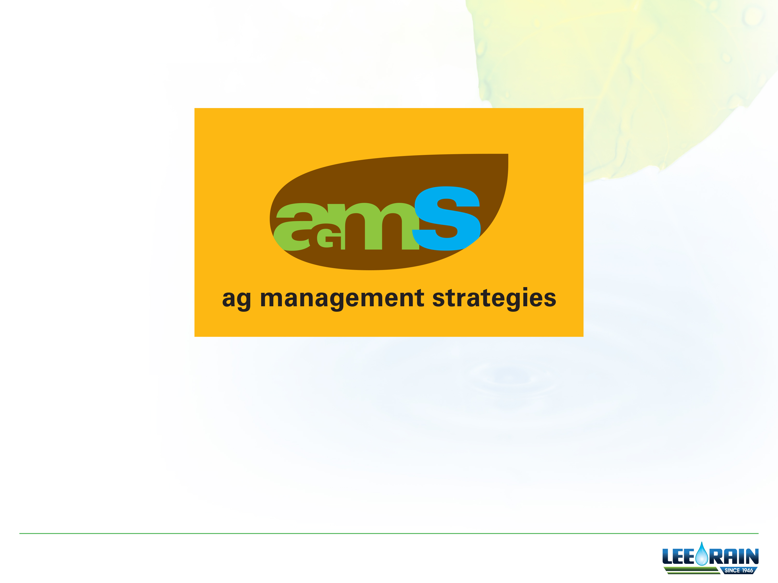
Changing The Way Your Farm Operates

Slide 3
Plant Empowerment Cycle

Slide 4
The Fact of the Matter
The traditional irrigation practice of alternatively flooding and drying out is counter productive
  Upsets the sensitive balance of the environment
  that the plants, and their roots, live in
  Induces plant stress which undermines
    Yield potential
    Quality targets
    Harvest timing

Slide 5
Traditional Irrigation Decisions
Human Interpretations
  Prescriptions
    Predictive Environmental and Weather Station Models
  Physical Plant Symptoms
    Wilted Plants
  Growth Stage
  Previous Year’s Success/Failure
  Instinct
KEY POINTS
Humans try to out guess the needs of the plant
Untimely irrigation decisions are costly

Slide 6
Traditional Irrigation Decisions
What are the shortfalls?
  Unnecessary short and long-term plant stress
    Irrigation Amount/Duration: Too much or too little
    Irrigation Timing: Too soon or too late
    Plant Nutrition: Too deep or bad timing
KEY POINT
Traditional irrigation does NOT address the plant’s real-time needs

Slide 7
Thoughts on Irrigation
KEY POINTS
Irrigation is an investment
Irrigation deserves
thorough understanding
and management
expertise
How do we use irrigation
to maximize returns?

Slide 8
Plant Empowerment Cycle
Core Elements
Precise Plant Intelligence
  Translated from the plant
Precise Evaluation
  Communicated
  to the machine
Precise Action
  Implemented back
  to the plant
KEY POINT
Put into practice to meet the precise crop needs—instantly
  What are the principles behind this methodology? Where do we start?

Slide 9
1) Precise Plant Intelligence
We accept the premise that plants are
  Aware of their environment,
  instantly adapting to
  changing conditions
…and that their root system
  Acts as a nerve center
  playing a key roll in
  formulating plant response
  (underground intelligence)
KEY POINT
Plant Intelligence is WHAT drives irrigation decisions

Slide 10
Interrelated Plant Senses

Slide 11
The Intelligent Plant

Slide 12
2) Precise Plant Evaluation
With our patent-pending analytics,
we translate information from the
Intelligent Plant to perform
Precise Evaluation
The most important
analytic factors:
Plant Water Health
Soil Water Health
Most Active Root Zone (MARZ)
KEY POINT
Precise Plant Evaluation is WHY
we make irrigation decisions

Slide 13
A) Plant Water Health
Plant Water Health is the indication of when the plant needs water
  Science and practice of understanding plant intelligence
    Proper water and oxygen ratios maximum root performance
    Positive and negative effect on the plant’s performance
  Defined as a real-time condition
    Plant’s yield potential is measured against the effects/impact
    of water stress (i.e. oxygen deficit and/or water deficit)
    Duration of the stress
KEY POINT
Overcoming the succession of soil moisture stress related factors
that limit plants from achieving their full genetic potential.

Slide 14
B) Soil Water Health
Soil Water Health is when the soil is out of balance
Healthy soil = proper water and oxygen balance
  Computations enhance crop production
    Oxygen Deficit Stress – Root systems require oxygen for respiration
    to carry out their functions
    Water Deficit Stress – When the water supply to roots become limiting, or transpiration rate becomes intense
    Measurables take place within the Most Active Root Zone (MARZ)
KEY POINTS
When water & oxygen imbalances occur - the plant is unable to optimize production
Successful agriculture depends upon proper Soil Water Health

Slide 15
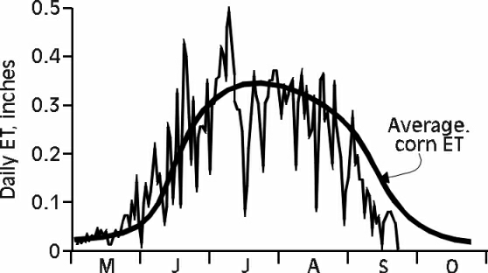
Plant Stress Management
Above = Plant Stress
Caused By Too Much Water
Below = Plant Stress
Caused by Too Little Water
KEY POINT
The goal is to tightly manage irrigation to the optimal needs of the plant.

Slide 16
Why Plant Stress Matters
KEY POINTS
Not optimizing
plant productivity
has a cost
Opportunity costs
are calculated
96 times per day
OPPORTUNITY POTENTIAL
100% STRESS FREE

Slide 17
    MARZ is the indication of where the plant needs water
B) Most Active Root Zone
KEY POINT
MARZ is the indication of WHERE the plant needs water

Slide 18
2) Precise Evaluation
___ __ _________ _________ ___ _____ _ _____ _______ __ ___ ___ _____ ___ ___ __ ____________ _______ ____ ___ ___ ____ _____ __ _____ __ ______ ____ _____ __ ___ ____
When we precisely determine the plant’s needs related to the Most Active Root Zone (MARZ), we dramatically improve Plant
and Soil Water Health in order to reduce Plant Stress on the crop.

Slide 19
3) Precise Action
Plant Triggered Irrigation takes action
without human intervention.
Meet precise crop demands for
water without the side effects
of negative plant stress
Supports real-time
communication
between…
  The growing plant (P)
  Action taking irrigation
  machines/devices (I)
KEY POINT
Plant Triggered Irrigation is HOW we implement irrigation

Slide 20
Plant to Irrigation (P2i)
Once the Plant Empowerment Cycle
is completed the plant responds
to a precise irrigation event
KEY POINT
The P2i system is designed
to do it all over again
in real-time

Slide 21
Without P2i
Without the P2i process:
The precise and timely
application of water
to meet precise plant
needs—that reduces
crop stress for
improving yields—
would be impossible!

Slide 22
Ag Management Strategies
Every Ag Management Strategies project we conduct
  Permits growers to see and grapple with
    Yield Impact principles
    How to bring this opportunity to life
  Designed for any grower seeking to
    Set goals early
    Achieve long-lasting success
KEY POINT
It’s a dramatic departure from the vast majority of analyses available to growers. Here’s why…

Slide 23
Ag Management Strategies
51 Ag Management Strategies projects were conducted in multiple states for 2015
  If we were able to reduce Plant Stress completely yield/revenue improvement of 37.6% is potentially available
Yield Impact Analysis
37.6%

Slide 24
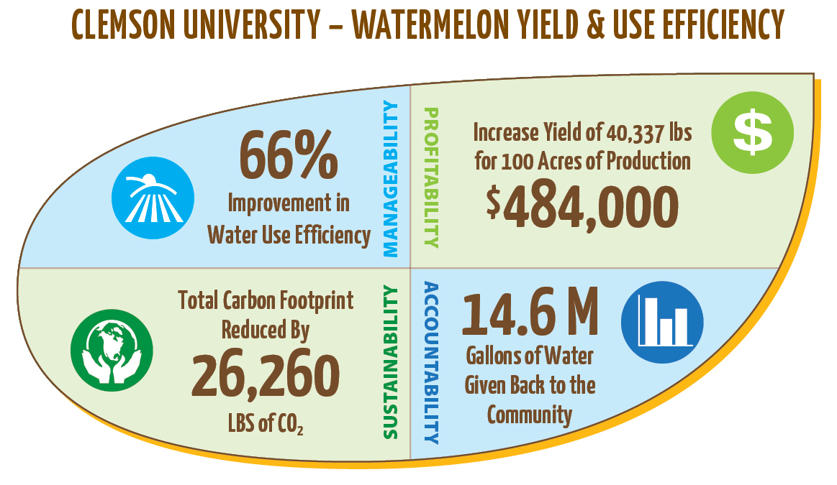
Measuring Outcomes
Measure Outcomes Compared
to Goals

Slide 25
P2i - Summary
Plant Intelligence is what drives irrigation decisions
Plant Water Health is when the plant needs water
Soil Water Health is when the soil is out of balance
MARZ (Most Active Root Zone) is where the plant needs water
Plant Triggered Irrigation is how information is implemented into an irrigation action
Plant to Irrigation (P2I) is the process used to utilize irrigation as an optimization tool

Slide 26
P2i
P2i is a comprehensive and powerful framework—
  Translation of the
  plant’s needs
  Communication of an instantaneous evaluation
  Implementation of
  precise actions
—that is designed to reduce
stresses on the plant that impact
the opportunity for higher yields
KEY POINT
Without P2i - YOU CAN’T DO IT!

Slide 27
Innovation
That’s why P2i, in
conjunction with
Ag Management Strategies,
is an innovation and optimization process
that will change
the way your farm operates.

Slide 28
Ag Management Strategies
How do I put into practice such a leading-edge optimization methodology on my farm?
Contact Lee Rain today to discuss how
Ag Management Strategies
might be right for you.

